Slide 1
CP introduction to computer and programming
SEMESTER:1ST SEM

Slide 2
Chapter 1 – Introduction to Computers and Programming
Outline
Hardware concept
Input devices
Output devices
Software concept
System software
Application software

Slide 3
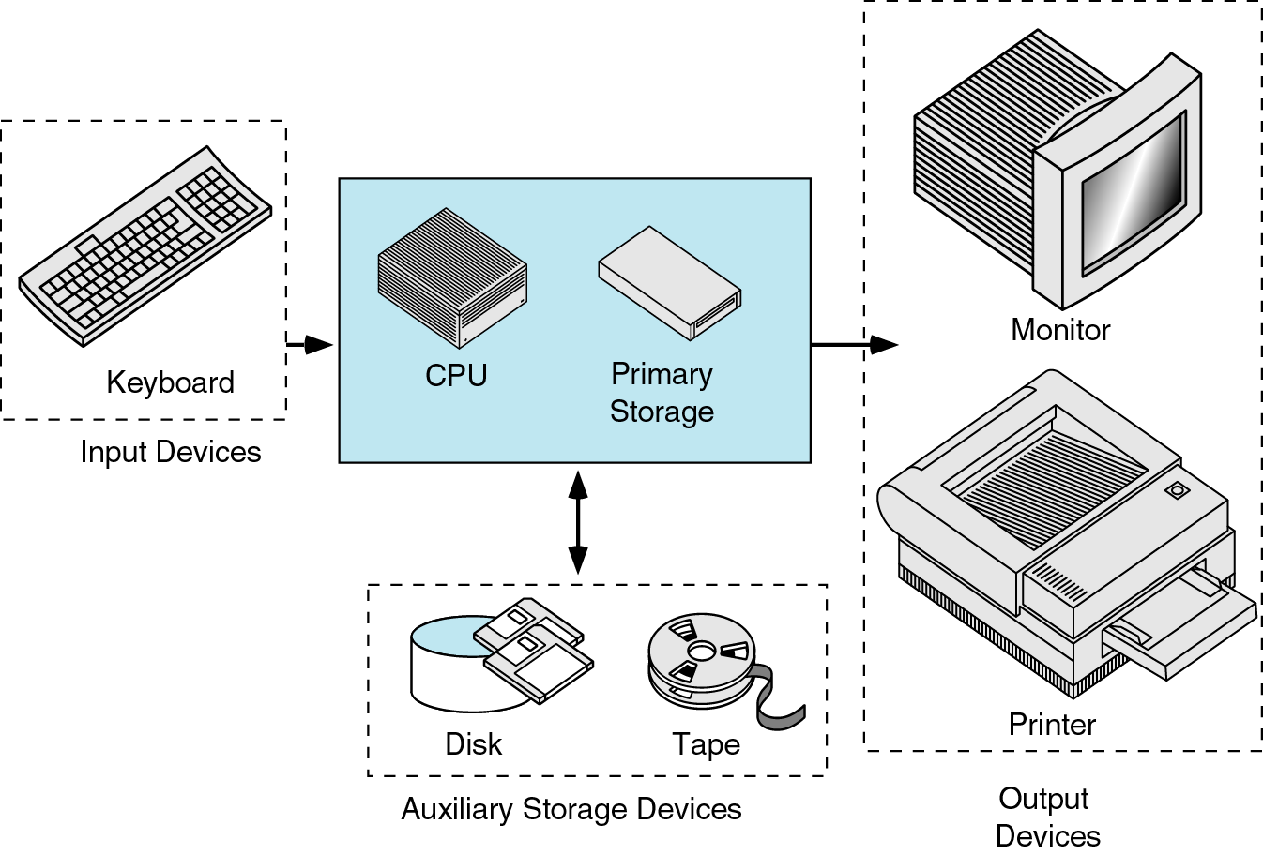
1.Harware concept
The physical devices that make up the computer are called hardware. The hardware units are responsible for entering, storing and processing the given data and then displaying the output to the users.
The basic hardware units of a general-purpose computer are keyboard, mouse, memory, CPU, monitor and printer etc.

Slide 4
2.INPUT DEVICES
They are used for accepting the data on which the operations are to be performed. Examples are keyboard, mouse, trackball etc.

Slide 5
2.1 KEYBOARD
A standard keyboard includes alphanumeric keys, function keys, modifier keys, cursor movements keys, spacebar, escape key, numeric keypad, and some special keys such as Page Up, Page Down etc.
The alphanumeric keys include the number keys and the alphabet keys.
The function keys are the keys that help perform specific task such as refreshing the web page, searching the file.
Modifier keys such as shift and control keys modify the casing style of a character or symbol.

Slide 6
2.2 Mouse
A mouse is small hand-held box used to position the screen cursor. Wheels or rollers on the bottom of the mouse can be used to record the amount and direction of movement.
Another method for detecting mouse motion is with an optical sensor. For these systems, the mouse is moved over a special mouse pad that has a grid of horizontal and vertical lines. The optical sensor detects movement across the lines in the grid.
The mouse allows the users to selects elements on the screen such as tool, icons and buttons, by positioning and clicking them.
The mouse consists of two buttons, a wheel at the top and a ball at the bottom of the mouse.

Slide 7
2.3 SCANNER
A scanner is an input device that converts documents and images as the digitized images understandable by the computer system.
The digitized images can be produced as the black and white images, Gray images or coloured images.
In case of colored images, an image is considered as a collection of dots with each dot representing a combination of red, green and blue color, in varying proportion.
There are following type of scanners:
1. Flatbed scanner
2. Drum scanner
3. Slide Scanner
4. Handheld scanner

Slide 8
2.4 JOYSTICK
A joystick consists of a small, vertical lever (called the stick) mounted on a base that is used to steer the screen cursor around.
Most joysticks select screen positions with actual stick movement; others respond to the pressure on the stick. Some joysticks are mounted on a keyboard; others function as stand-alone units.
In another type of movable joystick, the stick is used to activate switches that cause the screen cursor to move at a constant rate in the direction selected.

Slide 9
2.5 DIGITIZER
A common device for drawing, painting, or interactively selecting coordinate positions on an object is a digitizer. These devices can be used to input coordinate values in either a two-dimensional or a three-dimensional space.
Typically, a digitizer is used to scan over a drawing or object and to input a set of discrete coordinate positions, which can be joined with straight-Line segments to approximate the curve or surface shapes.

Slide 10
3.OUTPUT DEVICES
The data, processed by the CPU, is made available to the end user by the output devices. The most commonly used output devices are:
Monitor
Printer
Speaker
Plotter

Slide 11
3.1 MONITOR
A monitor is the most commonly used output devices that produces visual displays generated by the computer.it is also known as screen.
The monitor connected using the cables, is connected to the video card placed on the expansion slot of the motherboard. The display devices are used for visual presentation of textual and graphical information.
The monitor can be classified as cathode ray tube (CRT) monitors or liquid crystal displays (LCD) monitor. The CRT monitors are large and occupy more space in the computer, whereas LCD monitors are thin, light weighted and occupy less space.
The inner side of the screen contains the red, green and the blue phosphors. When the beam of electrons strikes the screen, it illuminates the and produce the image.
To change the colour displayed by the monitor, the intensity of the beam striking the screen varied.

Slide 12
3.2 Printer
The printer is the output device that transfer the text displayed on the screen, onto the sheet that can be used by end user.
Printer is an external device connected to computer using cables.
The printer/print device software is used to convert a document to a form understandable by the computer.
The performance of a printer is measured in terms of dots per inch (DPI) and pages per minute (PPM) produced by the printer.
Printers can be classified as: Dot Matrix printers, Inkjet printers and Laser printers.

Slide 13
3.3 speaker
The speaker is an electromechanical transducer that converts an electrical signal into sound.
They are attached to a computer as output devices, to provide audio output, such as warning sounds and internet audios. We can have built in speakers or attached speaker in the computer to warn end users with error audio messages and alerts.

Slide 14
3.4 plotter
The plotter is another commonly used output devices that is connected to a computer to print large documents, such as engineering or constructional drawings.
Plotters use multiple ink pens or inkjets with colors cartridges for printing.
A computer transmits binary signal to all the print heads of the plotters.
Each binary signal contains the coordinates of where a print head needs to be positioned for the printing.

Slide 15
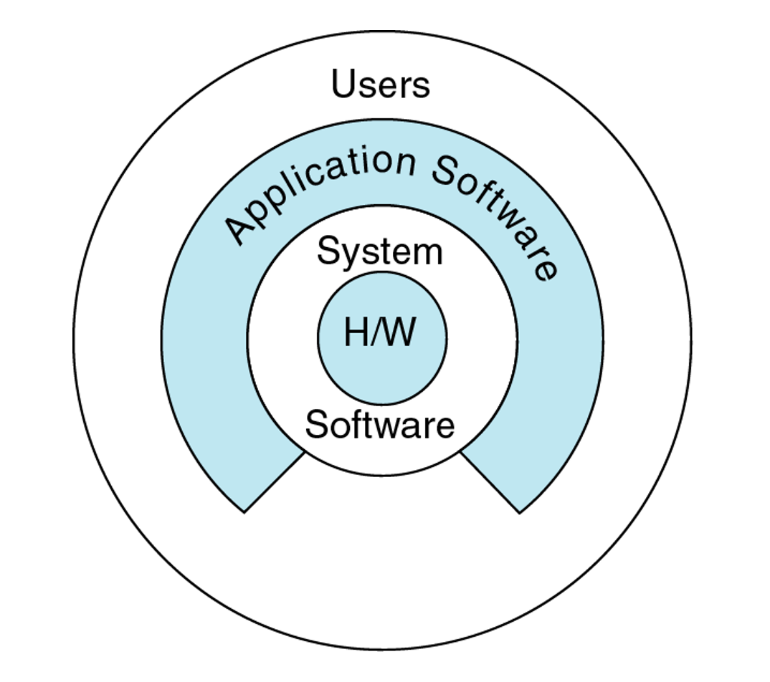
4. software
Software is defined as computer program, which include logical instructions used for performing a particular task on a computer system using hardware components.
The following are the two categories of software under which different types of computer program can be classified:
System software
Application software

Slide 16
4.1System software
System Software is the type of software which is the interface between application software and system.
Low level languages are used to write the system software.
System Software maintain the system resources .
It give the path for application software to run. An important thing is that without system software, system cannot run.

Slide 17
4.5 application software
Application software is computer program that is executed on the system software.
It is designed and developed for performing specific tasks
it is also known as end-user program.
Application software is unable to run without the system software, which such as os and utility program.
It resides above system software.
First user deal with system software after that he/she deals with application software.

